Slide 1

BEACON (Hi –Tech Marine Loading & Path Detection)
-Binit Kumar
PT0981122

Slide 2
Scene
XYZ is the courier and Logistics company , available across whole Asia.
The CEO wants to reduce cost and time by reducing complexity in the system by Information Technology .
They require a new system that help them on the complex and tedious task and make a clear cut view of problem area.

Slide 3
Why Beacon ?
System is for Logistics and Marine Enterprises.
To solve the Vehicle Routing ( Travelling Salesman Problem)
To solve Container Loading Problem of Ships /trucks
Smart Algorithms that solve and find the best optimized solution of TSP and CLP

Slide 4
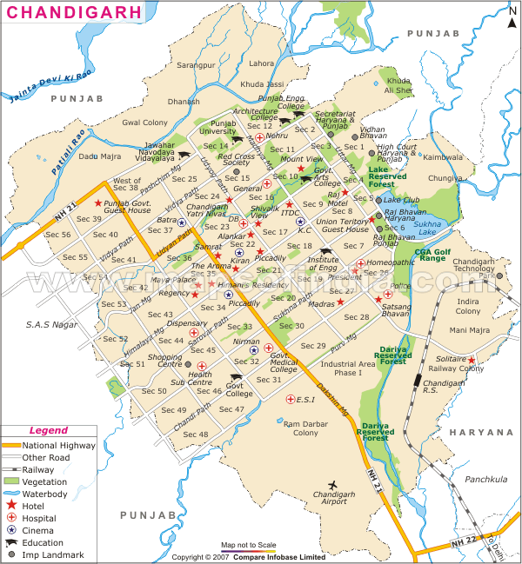

Slide 5
Container loading

Slide 6
Target Audience
Shipping Companies/SMEs /Courier Company - Organization who manages a large supply or export/import packages to move on.
Skilled People targeted – Package planner, Package Loader, Insurance People, Manager, Accounts. The system also targets different worker of same enterprise according to work divided.
General/Typical Users -Any person who wants to control their data can use the system.
Research peoples and Students – The advance algorithm and problem solving techniques can be used in academics and research.

Slide 7
Benefits
Reduced complexity in the problem
Graphical view of vehicle route and load plan
Organized Data and accessibility
Cost Benefits
Time Benefits
Increased Enterprise/Employee productivity
Reduce Stress

Slide 8
Core Functionalites
Functionality | Description
Data entry and Unique ID | The information about each goods and container need to be logged in the system with unique identification.
New Algorithms for TSP ( Research Paper ) | Genetic Algorithm, simulated annealing or Ant Colony Optimization (ACO )to determine the shortest and the best path for transportation.
Implementation of TSP | Implementation of TSP problem on graphs taking co-ordinates from a real world scenario
New Algorithms for CLP (Research Paper) | Integral Optimal Algorithms for CLP that provides the maximum container loading and ship balance.
Implementation of CLP | Implementation of Container loading for a ship with various box of different size

Slide 9
Enhanced n Special
Functionality | Description
Language Support | Different Major Language Support for the system.
Excel Data Entry | Data entry through excel sheet.
Interactive Report and Document Generation | Automatic and downloadable Insurance , Bill , Transport Agenda and other report generation
Functionality | Description
2D /3D view of CLP | Loading Plan of containers
Map Editor for TSP | Map Editor for TSP

Slide 10
New Concept , theories and Technologies to be learnt
Concepts –
Genetic algorithms and optimization
Theories –
Map the real world problem into algorithmic structure in solvable form(graph theory) . It requires data gathering and research techniques
Technology –
Visual Basic 10

Slide 11
Literature Review
“All the fun is powered by algorithm, we may not realise it but we live in the algoworld “
Advanced algorithms are a smart changing key to change the way anything computes . It makes the things readable and processed smartly at the same time , that is not possible in any other way .They acquire the sensibility of truth because they repeat over and over again. And they ossify and calcify and they become real

Slide 12
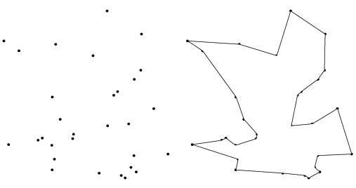
Travelling Salesman Problem
"If there are n cities a salesman must visit, and the distance between each pair of these cities is given, find the shortest tour where each city is visited exactly once and returning to your starting point."

Slide 13
Container Loading Problem
The loading problem may include different practical constraints. The performance of the GA is demonstrated by a numerical test comparing the GA and several other procedures for the container-loading problem

Slide 14
Genetic Algorithm
Genetic Algorithm is a search heuristic algorithm that is routinely used to generate useful solutions to optimizations and search problems.
It generated solutions to optimization problems using techniques inspired by natural evolution, such as inheritance, mutation, selection and crossover.
Genetic algorithms are one of the best ways to solve a problem for which little is known.

Slide 15
Review of Similar Systems
2D Load Packer
PackVol
Google Map
The details of the review have been documented and presented properly in the mid point report

Slide 16
Primary Research
Questionnaires
Objective of the survey:The developer called for the survey in order to establish facts related to users and their use of tools on routing and loading
Sampling Group: The developer has decided to restrict the sampling group into two users. New Users and Existing users
Writing the Questionnaire: The questionnaires duly approved by the supervisor has been attached in the appendix section of the mid-point report.

Slide 17
Primary Research
Interviews
Objective: The developer wants to use Interview technique in addition to the survey performed. The information thus gathered will help the developer follow-up, amplify and clarify the information already gathered.
Interviewees: The developer has decided to conduct the interview with research peoples on genetic algorithms and people belongs to loading and route planning.
Questions to be asked: The interview questions duly approved by the supervisor has been attached in the appendix section of the mid-point report.

Slide 18
Secondary Research
Programming Language
Language considered – Visual Basic and Java
Language chosen – Visual Basic
Why Visual Basic ?
Visual Basic is easy but powerful language to use and with OOPS concepts and advanced support for graphics class and procedures.

Slide 19
Secondary Research
Why Visual Basic is best suited for BEACON ?
Object Oriented Design
Protection and efficiency
Indexes
Exception Handling
Error Elimination
Graphical User Interface
Graphics Class
Stream Writer and Binary Writer

Slide 20
Secondary Research
Why Advanced Waterfall Model ?
Stable Project Requirement
Progress of System is measure able
Strict Sign off Requirements
Flexibility in V –model
Change in basic design is also possible

Slide 21
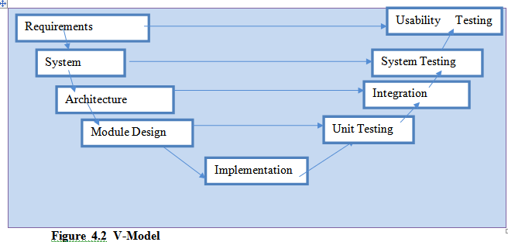

Slide 22
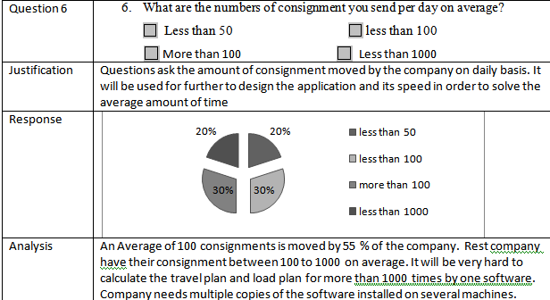
Analysis of Questionnaire are given
In appendix section , analysis of questionnaire are given with justification and conclusion in form of pie chart

Slide 23
Thank You
Questions ???

